Slide 1
Leaf Disease Detector
Ashfaq Uddin Ahmed
1911848042

Slide 2
What was the project?
I thought of doing this project because, especially in Bangladesh, where most people depend on agriculture, it is essential for the crops to do well for them. However, the present way of detecting the leaf disease is through naked eyes, which takes a lot of time, effort, and manpower; that is why I thought of doing a project.
This project is based on the image classification technique. I am going to use Deep Learning for this project. I familiarized with the convolution neural network(CNN). In the project, we are going to use one of the transfer learning technique i.e InceptionV3.

Slide 3
What did you do ?
1) Import required library
2) Import the dataset via google drive
3) Pre-process the data accordingly
4) Select the model or the algorithm (CNN using InceptionV3)
5) Build the model
6) Separate your train and test data
7) Then fit the model according to your train data
8) Predict using test data and see the results

Slide 4
What did you do ?
Tensorflow
TensorFlow is a free and open-source software library for machine learning and artificial intelligence.
Keras
Use the keras module from tensorflow Keras is an open-source software library that provides a Python interface for artificial neural networks. Keras acts as an interface for the TensorFlow library.
InceptionV3
Inception-v3 is a convolutional neural network that is 48 layers deep. You can load a pre-trained version of the network trained on more than a million images from the ImageNet database, compared with other contemporary models.
The Inception V3 model used several techniques for optimizing the network for better model adaptation.

Slide 5
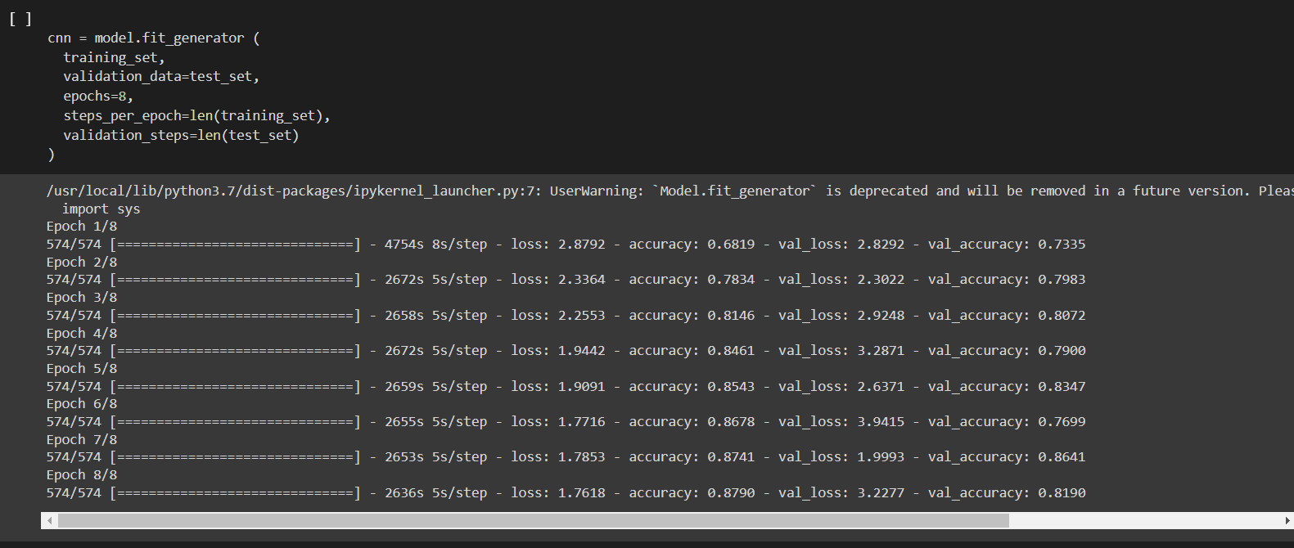
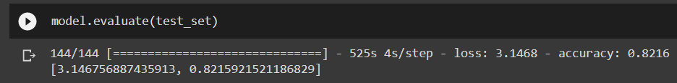
ResULTS
82% ACCURACY WITH 8 EPOCH

